Slide 1
2026 GAR Changes
2026GARCHANGES

Slide 2
Universal Changes
Statute of Limitations reduced to 1 year
“Commission” corrected to “Compensation”
Capitalization of defined terms
“Notices” becomes “Notice”
Format for dates updated to accommodate different software (no more __ day of __, 2026)

Slide 3
Brokerage Agreements

Slide 4
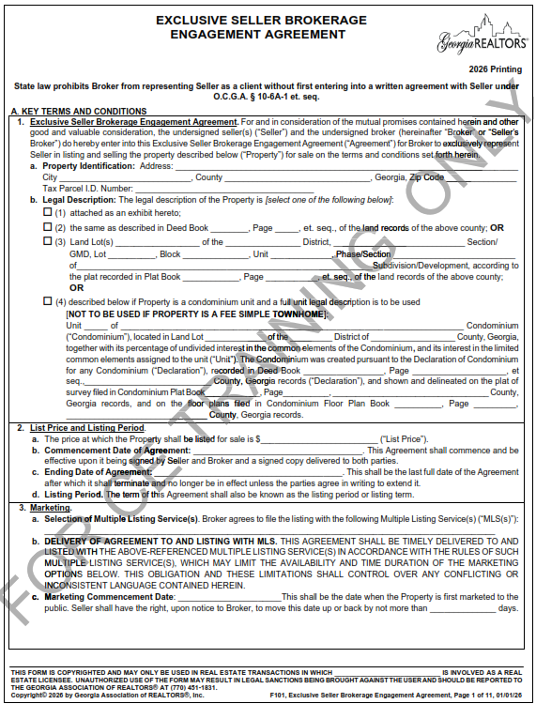
F101:
Exclusive Seller Brokerage Engagement agreement

Slide 5
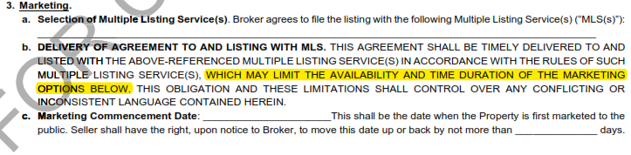

F101 Exclusive Seller Brokerage Engagement Agreement
A(3)(b) Delivery of Agreement to and Listing with MLS
Sellers select their preferred marketing option but if in conflict, the rules of the MLS control
A(3)(c)(i) Marketing Commencement Date, Coming Soon
New Paragraph

Slide 6
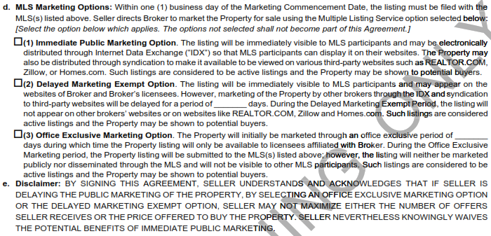
F101 Exclusive Seller Brokerage Engagement Agreement
A(3)(d) MLS Marketing Options
New Paragraph
A(3)(d) MLS Marketing Options
New Paragraph
Options not selected do not become part of the Agreement. There is no default option so you must make a selection!

Slide 7
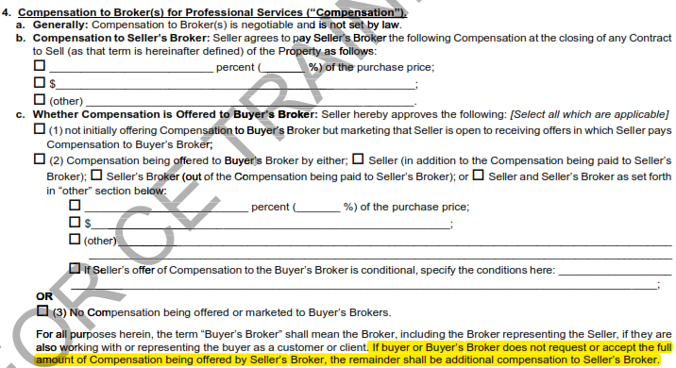
F101 Exclusive Seller Brokerage Engagement Agreement
A(4)(c) Whether Compensations is Offered to Buyer’s Broker
Clarifies that shared compensation not requested or accepted by Buyer’s Broker is retained by Seller’s Broker.
Universal Change: F104

Slide 8
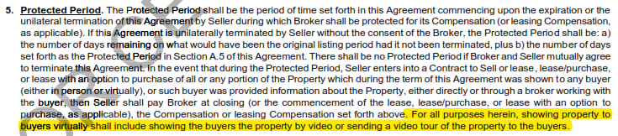
F101 Exclusive Seller Brokerage Engagement Agreement
B(5) Protected Period
New Language about showing property to buyers virtually
Universal Change: F104

Slide 9
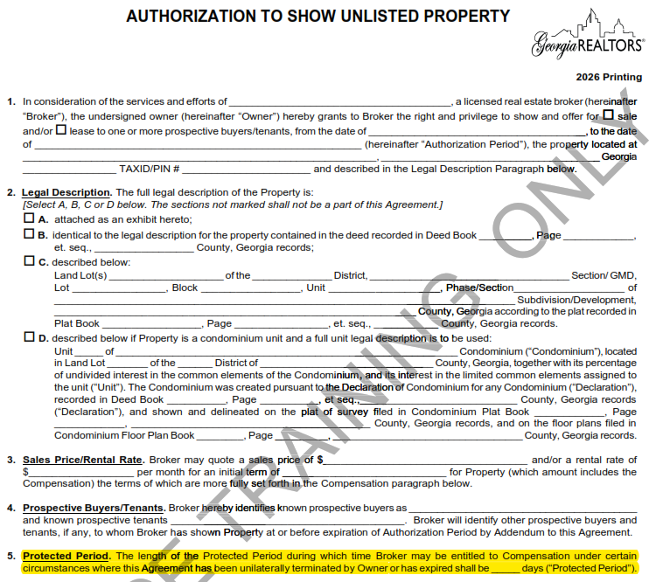
F107 Authorization to Show Unlisted Property
Paragraph 5 Protected Period –added to the first page as a stand-alone term
Paragraph 6(B) further defines the Protected Period. The language was updated so that it aligns with the terms of the Protected Period in F101 and F104.

Slide 10
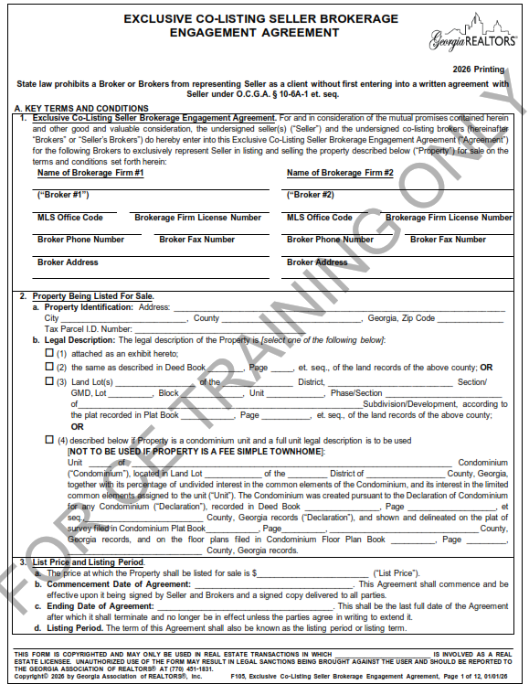
NEW FORM! F105 Exclusive Co-Listing Seller Brokerage Engagement Agreement
Used when two Brokerages will co-list a property.
Outlines the division of responsibilities and sharing of Compensation
Why as a broker might you want to co-list a property with another brokerage?

Slide 11
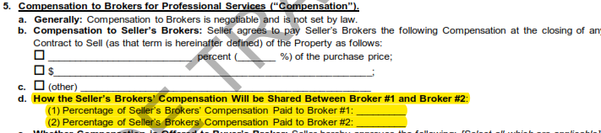

F105 Exclusive Co-Listing Seller Brokerage Engagement Agreement
The terms for Compensation look nearly identical to F101 but also includes an agreement between the two listing brokerages to share Compensation.

Slide 12
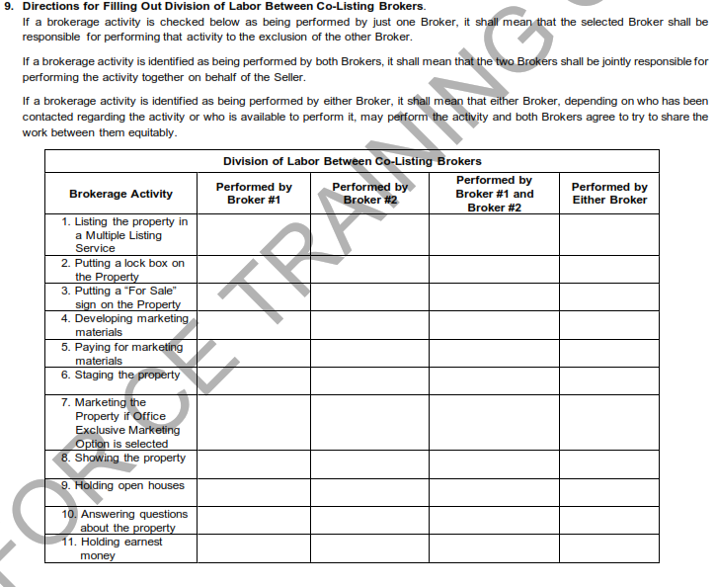
F105 Exclusive Co-Listing Seller Brokerage Engagement Agreement
A(9) Directions for Filling out Division of Labor Between Co-Listing Brokers
Makes clear who is responsible for each task

Slide 13
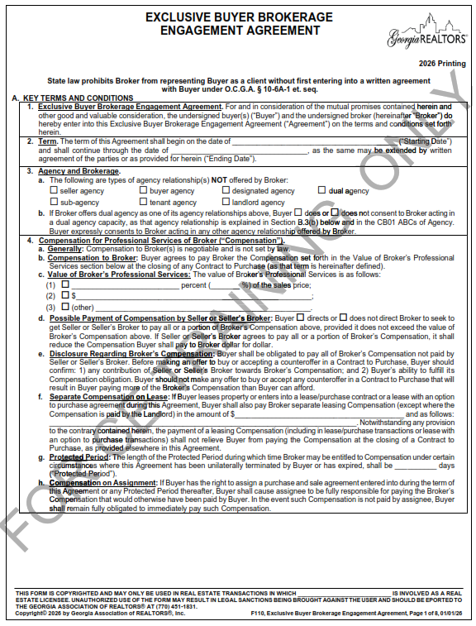
F110:
Exclusive Buyer Brokerage Engagement agreement

Slide 14
F110: Exclusive Buyer Brokerage Engagement Agreement
A(4)(g) Protected Period
Clarified that this only applies if unilaterally terminated or expired.
B(4)(d) Protected Period Definition of the Protected Period updated to align with the definition in the Seller Brokerage Agreements.
Universal Change: F113
Protected Period added to F116 (Agreement to Work with Buyer as a Customer)

Slide 15
Purchase and Sale Agreement

Slide 16
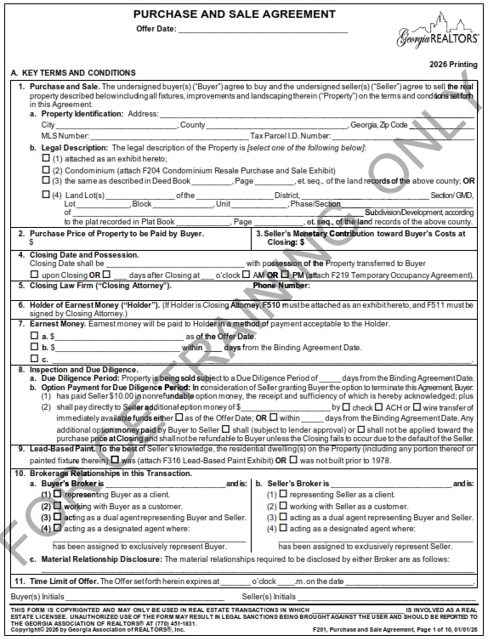
F201 Purchase and Sale Agreement

Slide 17
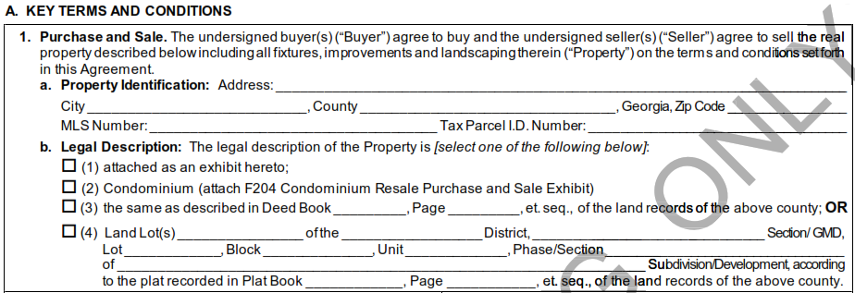
Purchase and Sale Agreement (F201)
A(1) Purchase and Sale
Identify the property being sold
Practice Tip! If there are multiple parcels makes sure to include each parcel ID and that the attached legal description includes all parcels.
If you don’t have the legal description you can use the Deed Book and Page reference.

Slide 18
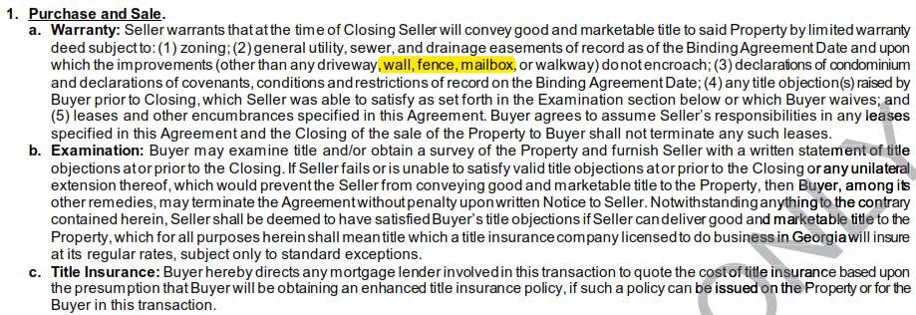
Purchase and Sale Agreement (F201)
B(1) Purchase and Sale
Seller warrants that they will convey good and marketable title
Language added to clarify that encroachments on an easement by a wall, fence, or mailbox are acceptable encroachments - Universal Change: F210, F213, F228, F243
Good and marketable title is, “title which a title insurance company licensed to do business in Georgia will insure at its regular rates, subject only to standard exceptions.”
A buyer can raise a title objection anytime prior to closing.
If your buyer wants to raise a title objection you need to send Seller a written statement of the objection.
Practice Tip! Just because something is on title doesn’t automatically make it a title defect.

Slide 19
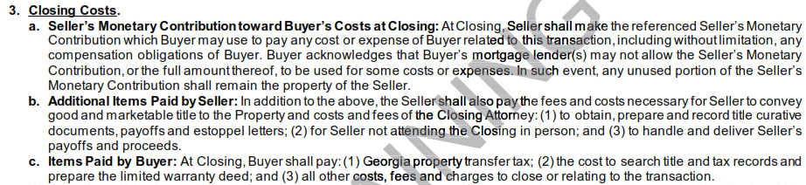
Purchase and Sale Agreement (F201)
A(2) Purchase Price of Property to be Paid by Buyer and A(3) Seller’s Monetary Contribution toward Buyer’s Costs at Closing
Practice Tip! Remember that all contracts are cash contracts UNLESS you attach a financing exhibit
B(3) Closing Costs
Seller paid closing costs can be used for ANY cost or expense of Buyer related to this transition – this is a very broad definition

Slide 20
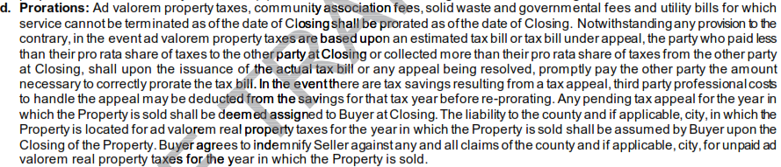
B(3)(d) Prorations
Jan – May:
Estimate based on previous year
May – August:
Estimate based on Tax Assessment
August – December:
Prorate actual bill
How we handle tax prorations is based on the closing date!
This can be modified based on learning new information
Seller moved prior to January 1st so exemptions won’t apply
New Construction
Significant remodel in prior year

Slide 21
Purchase and Sale Agreement (F201)
A(4) Closing Date and Possession
Closing is final when we:
have all funds;
have all signed documents; and
receive funding approval.
The seller receiving their proceeds is not a requirement for Closing to be final. There are times when a seller may not receive their proceeds until the following business day. Remember that technically the closing date runs until 11:59pm.

Slide 22
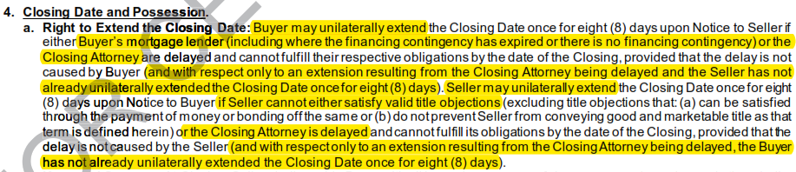
B(4)(a) Right to Extend Closing Date
8pm notice deadline removed
New language specifies the reason that Buyer and Seller can each extend and gives both parties the right to unilaterally extend one time.
If there is no financing contingency attached Buyer still has the right to extend for lender delay – F401 removes this right to extend for lender delay.
Universal Change: F210, F213, F228, F243

Slide 23
Unilateral vs. Mutual Extension
Which one should you use?
Unilateral:
Is exercised by one party under a specific right
Only amends the Closing Date, it does not change possession
Limits on how many times it can be used
Use the Notice to Unilaterally Extend Closing Date for Eight Days (F270)
Mutual:
An agreement between both parties to change the closing date
Can be done by amendment or the Amendment to Change Closing/Possession Date (F716)
F716 allows you to change the Closing Date and Possession at the same time and terminate the right to unilaterally extend.

Slide 24
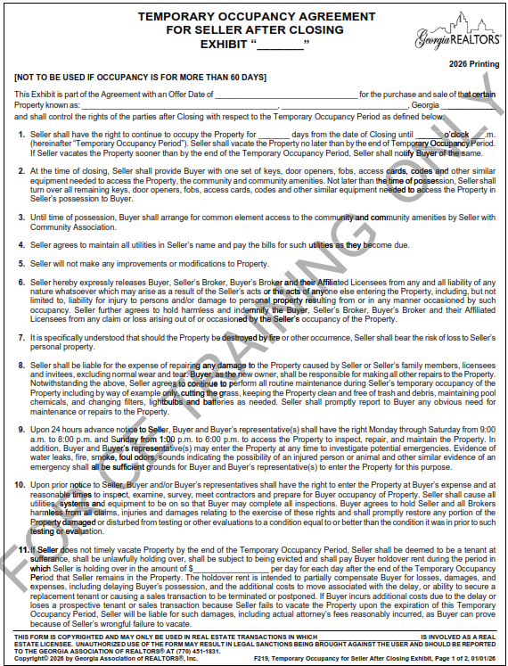
Purchase and Sale Agreement (F201)
A(4) Closing Date and Possession
Things to think about during temporary occupancy F219:
Cannot be longer than 60 day
Seller will maintain all utilities
Buyer and Seller should call their insurance agent to discuss coverage during the temporary occupancy
Seller is only responsible for damage caused by seller
Buyer is still responsible for wear and tear
Buyers have a right to access the property
Make sure your hold over rent is significant

Slide 25
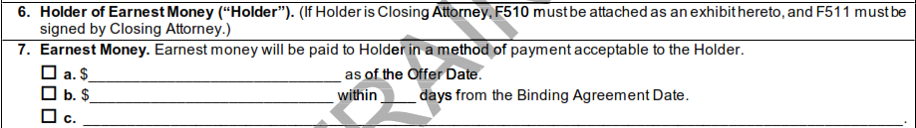
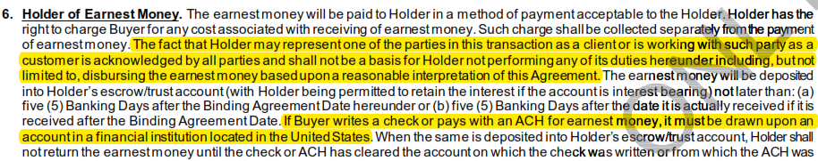
Purchase and Sale Agreement (F201)
A(6) Holder of Earnest Money (“Holder”) and A(7) Earnest Money
Make sure the earnest money is enough to make your Seller whole in case of Buyer default.
B(6) Earnest Money now clarifies that when submitted via check or ACH, earnest money must come from a US bank account and that Holder representing a party does not absolve them of their obligation to perform their duties as Holder.
Universal Change: F210, F213, F228, F243

Slide 26
B(7) Earnest Money
Disbursement of Earnest Money
When Buyer is entitled to the earnest money
Failure of the parties to enter into a binding agreement;
Failure of any unexpired contingency or condition to which this Agreement is subject;
Termination of this Agreement due to the default of Seller; or
Termination of this Agreement in accordance with a specific right.
Holder may disburse upon
Closing of the Property
A subsequent written agreement of Buyer and Seller;
Court order (interplead);
Failure of the parties to enter into a binding agreement; or
Upon issuance of a 10-day letter*
*Remember! In a cash transaction the closing attorney cannot send a 10-day letter!

Slide 27

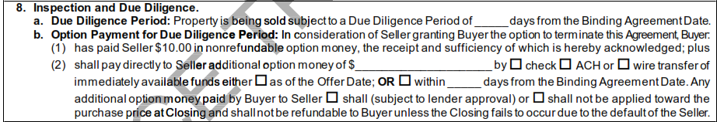
Purchase and Sale Agreement (F201)
A(8) Inspection and Due Diligence
Buyers may terminate for any reason during Due Diligence.
Seller has no right to terminate during Due Diligence.
Buyer may continue to inspect the Property even after Due Diligence ends.
Option Money can be an underutilized tool that can make your offer stand out.

Slide 28
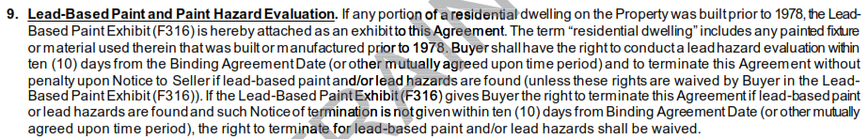
Purchase and Sale Agreement (F201)
A(9) Lead-Based Paint
B(9) Lead-Based Paint and Paint Hazzard Evaluation makes it clear that “residential dwelling” includes any painted fixture or material used that was built or manufactured prior to 1978

Slide 29

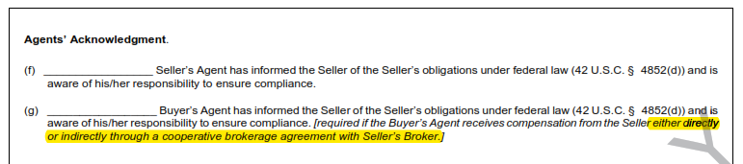
F316 Lead-Based Paint Exhibit
This form and the various checkboxes/initials are dictated by the EPA
In July 2024, the EPA added the requirement for the agent to acknowledge that they informed the Seller of their disclosure obligation
Updated to clarify that this applies if seller is paying Buyer’s Agent directly OR through the Seller’s Broker
Why as a broker might you want to require a lead-based paint exhibit on a property built after 1978?

Slide 30
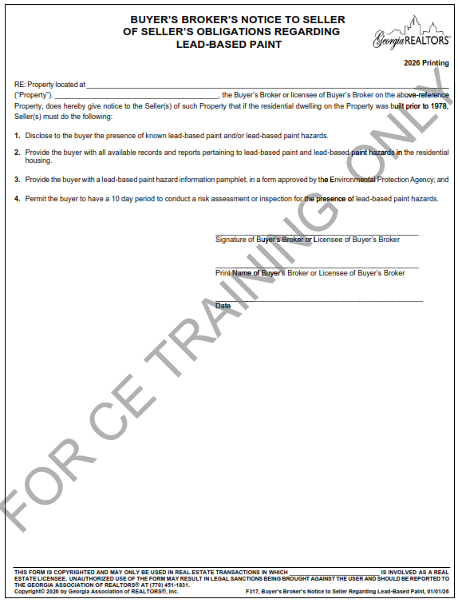
F317 Buyer’s Broker’s Notice to Seller of Seller’s Obligations Regarding Lead-Based Paint
If Buyer’s Broker receives compensation from the Seller (either directly or through Seller’s Broker), they are required to inform Seller of their disclosure obligations
This is a notice so there is nothing for Buyer or Seller to sign
Remember notice to the Seller’s Broker is deemed notice to the Seller
In order to initial the Lead-Based Paint Exhibit attached to the offer, you must send this notice BEFORE sending the offer

Slide 31
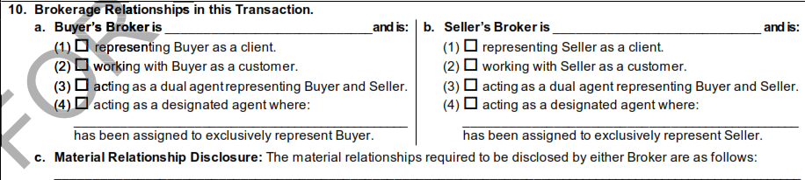
Purchase and Sale Agreement (F201)
A(10) Brokerage Relationships in this Transaction
How do you define a material relationship?
B(10)(a) Agency Disclosure
Brokers do not owe a fiduciary duty but be careful that you do not say anything that would create a fiduciary duty!
Universal Change: F210, F213, F228, F243

Slide 32
Duty of Reasonable Care vs. Fiduciary Duty in Closings
 | Real Estate Agent: Duty of Reasonable Care | Closing Attorney: Fiduciary Duty
Nature of the Duty | Perform services with the skill, diligence, and competence of a reasonably prudent licensed agent in similar circumstances. | Act in the client’s best interests at all times, placing the client’s interests ahead of your own or anyone else’s.
Primary Obligation | Facilitate the transaction, provide market guidance, assist with negotiations, and help navigate contract steps. | Protect legal rights, ensure documents and title are accurate, advise on legal risks, and safeguard client funds.
Conflict of Interest | Conflicts must be disclosed. | Must avoid conflicts. Many conflicts are non-waivable.
Standard of Evaluation | Agents are no guarantors of outcomes. They’re expected to avoid negligence and to perform their licensed role within the limits of their training and legal authority. | Must act competently and with undivided loyalty and trust. May face significant liability if they benefit personally or allow divided interests to influence their judgment.

Slide 33
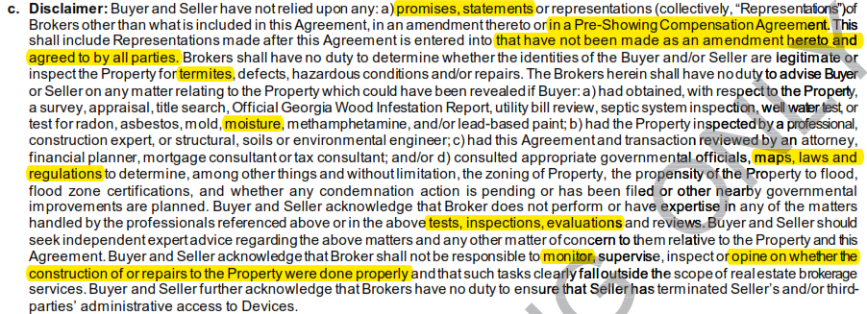
F201 Purchase and Sale Agreement
B(10)(c) Disclaimer
Further clarified/limited the obligations of the Brokers
Universal Changes: F210, F213, F228, F243

Slide 34
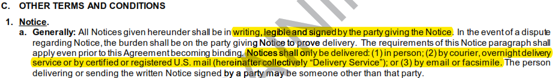

F201 Purchase and Sale Agreement
What is Notice?
When is Notice deemed delivered?
The earliest of the following:
When the parties receive the written Notice;
When written Notice is delivered to the address of the party; or
When the notice is sent via email or fax
Practice Tip! Remember that Notice must be sent using the contact information set out in the Agreement – make sure you are sending it to the right email!
Remember! Notice to the Broker is deemed Notice to their client.

Slide 35
C(2) Default
Remedies
C(2)(a) Remedies of Seller
Retain earnest money; and
Seller may sue Buyer for any portion of the earnest money that was not paid, returned for insufficient funds, or if payment was stopped
(C)(2)(b) Remedies of Buyer
Seek specific performance; or
Terminate, have earnest money returned, and pursue any other remedy available at law

Slide 36

F201 Purchase and Sale Agreement
C(4)(c) Delays Caused by Emergencies
Remember that this only applies to emergencies declared AFTER the Binding Agreement date;
The extension only applies to unexpired time deadlines;
Limits the extension to 8 days; and
No deadline is extended if you went binding during an emergency.

Slide 37
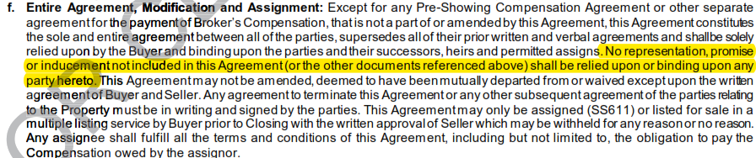
F201 Purchase and Sale Agreement
C(4)(f) Entire Agreement, Modification and Assignment
Remember! All terms must be in the Agreement
Just because something is in the MLS doesn’t mean it is part of the contract (i.e. square footage) unless you add it via a special stipulation or amendment. Do NOT attach the MLS printout as an exhibit.

Slide 38
F201 Purchase and Sale Agreement
C(4)(o) Property to Be Delivered in Clean Condition
Added:
That construction materials may not be left on the Property;
However, if Seller identifies that something will remain with the Property (i.e. paint cans) it may remain; and
That firewood is not considered debris.
How would you distinguish firewood from a tree limb?
Universal Change: F210, F213, F228, F243

Slide 39
F201 Purchase and Sale Agreement
C(4)(p) Rules for Interpreting This Agreement
Amendatory Clause
Amendments
Boilerplate Language
Special Stipulations
Handwritten and Initialed Changes
Exhibits and Addenda

Slide 40

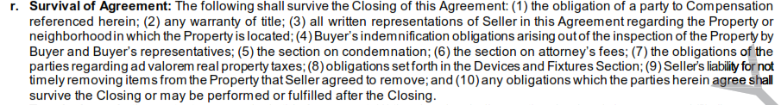
F201 Purchase and Sale Agreement
C(4)(r) Survival of Agreement only a few obligations survive Closing.
If you want to make sure an obligation survives closing all you need to add is, “this obligation shall survive Closing.”
.

Slide 41
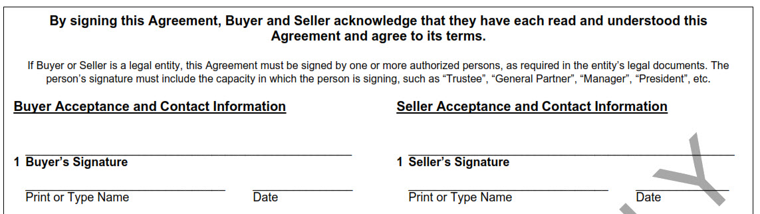
F201 Purchase and Sale Agreement - Signatures
Remember! A legal entity does not have its own signature it must use the signature of an individual who represents the entity.

Slide 42
How do you sign the contract?
Type of client | Who signs? | Signature Examples | Docs to send with the contract
Estate owner | Executor or Administrator signs as “Executor or Administrator of the Estate of homeowner” | Sally Seller, as Executor of the Estate of Simon Seller, deceased OR Sally Seller, as Administrator of the Estate of Simon Seller, deceased | Letters Testamentary and Will OR Letters of Administration (must probate estate to sell)
Trust | Trustee of the trust | Sally Seller, as Trustee of the Sally Seller Trust dated 7/7/2021 | Trust Agreement or Certificate of Trust (a/k/a memo of trust)
Corporation | President or Vice President of corporation (a/k/a CEO or CFO) | Simon Seller, as President of ABC, Inc. | Corporation’s Articles of Incorporation
Limited Liability Company (LLC) | Member or Manager of LLC | Sally Seller, as Member of ABC, LLC OR Sally Seller, as Manager of ABC, LLC | LLC Operating Agreement
Power of attorney (POA) | POA signs as “attorney in fact for client” | Sally Seller, as Attorney-in-fact for Simon Seller | Original POA

Slide 43

Counteroffer to or the Modification of the Unaccepted Original Offer (F249)
Counteroffer Tips, Ticks, & Reminders
Only the terms of the counteroffer which change or conflict with the original offer change. Leaving the term blank, as “NC”, or that do not conflict, do not change.
Do not use “NA” in the counteroffer! It creates confusion.
The counteroffer incorporates by reference all terms of the original offer so only the counteroffer needs to be signed to be legally binding.

Slide 44
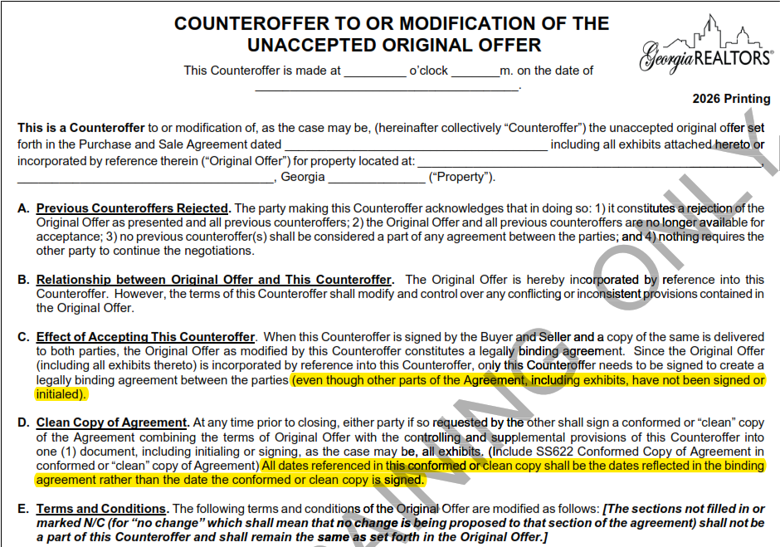
Counteroffer to or the Modification of the Unaccepted Original Offer (F249)
Added language clarifying that when signing the counteroffer you do not need to sign or initial the exhibits.
New language clarifying that in a conforming copy the dates in the conforming copy are based on the dates in the original binding agreement.
When might you want to use a conforming copy?

Slide 45
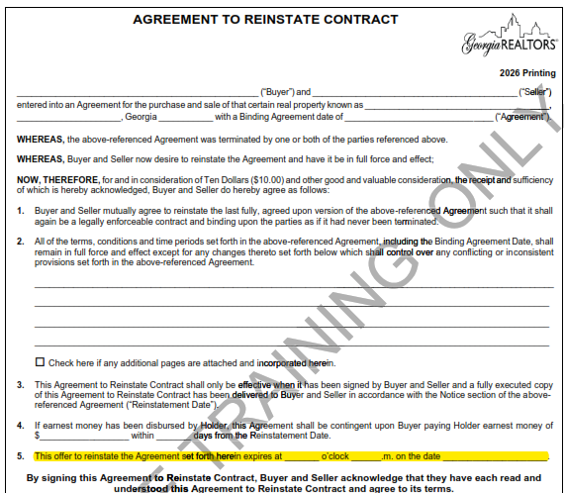

Agreement to Reinstate Contract (F290)
New paragraph 5 adding an expiration to the offer to reinstate.

Slide 46
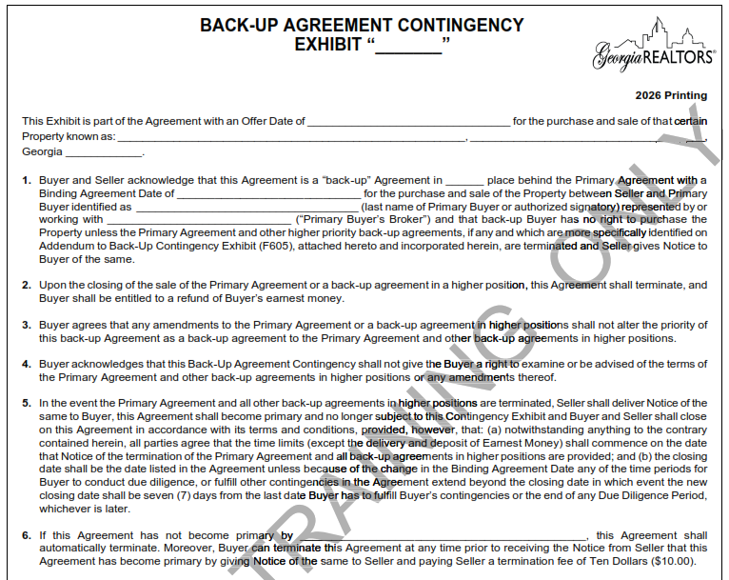
Back-Up Agreement Contingency Exhibit (F604)
Back-Up Agreement Reminders
Don’t hesitate to make a back-up offer. We’ve seen many back-up offers become successful!
Timelines in the contract run from when the Buyer receives notice that they have become the Primary Agreement.
Earnest Money is due when the Back-Up Agreement is signed.

Slide 47
Exhibits

Slide 48
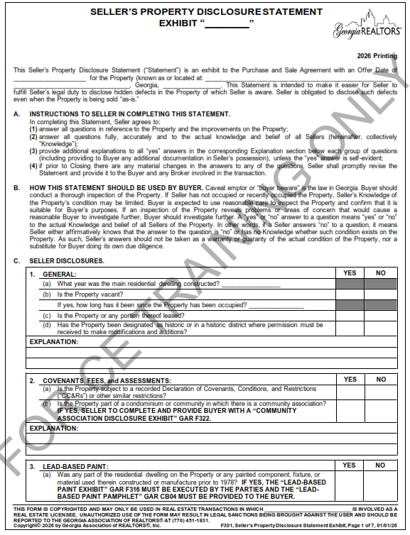

F301 Seller’s Property Disclosure Statement Exhibit

Slide 49
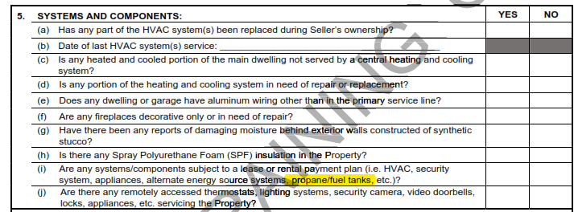
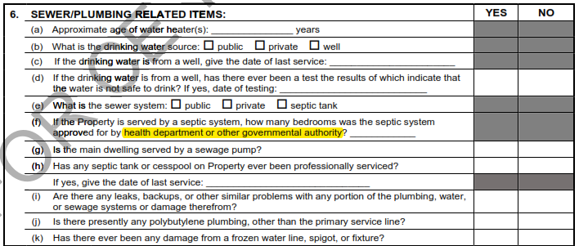
F301 Seller’s Property Disclosure Statement
Clarified C(5)(i) and C(6)(f)
Universal Change: F304

Slide 50
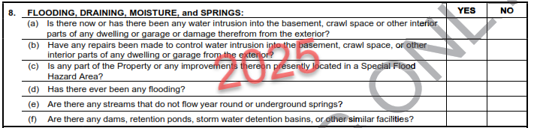
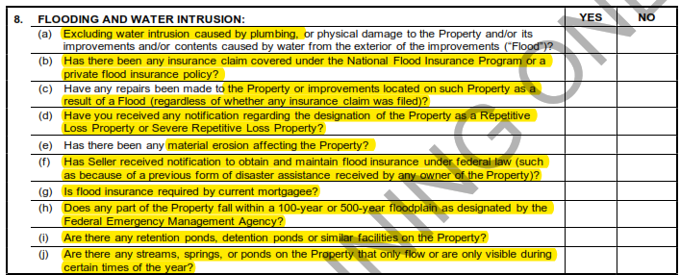
F301 Seller’s Property Disclosure Statement
Completely overhauled C(8)

Slide 51
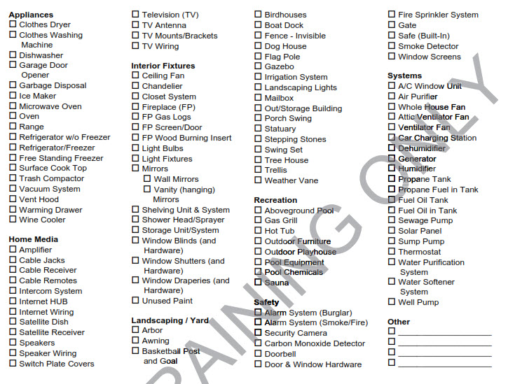
F301 Seller’s Property Disclosure Statement
No new items added to the fixtures checklist

Slide 52
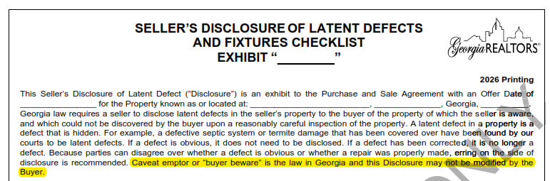
F302 Seller’s Disclosure of Latent Defects and Fixtures Checklist Exhibit
Added new language to the intro paragraph.

Slide 53
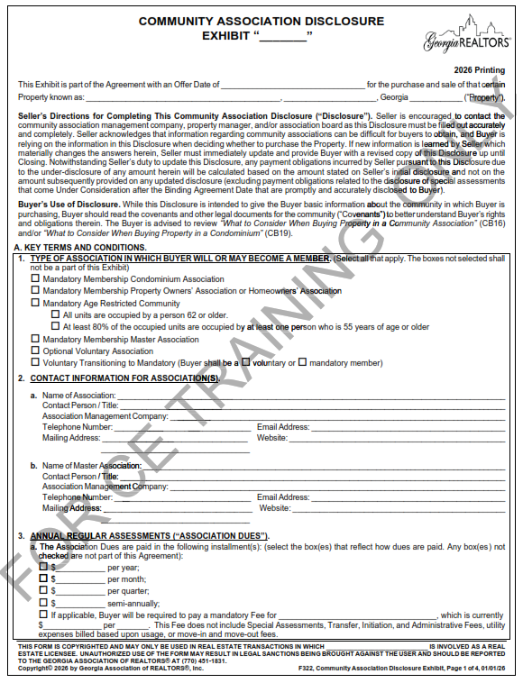

F322 Community Association Disclosure

Slide 54
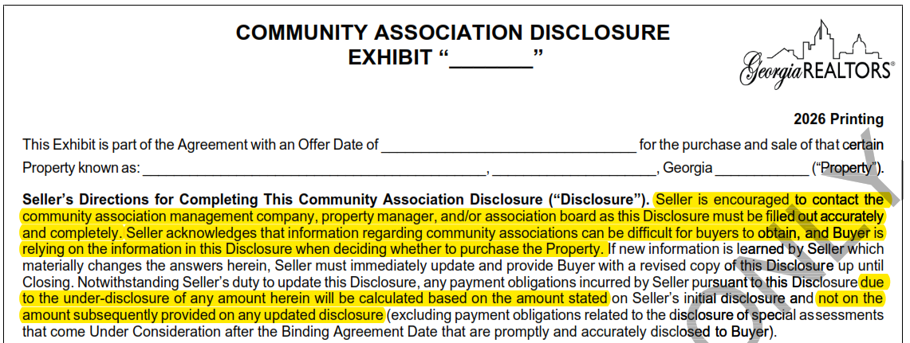
F322 Community Association Disclosure
Added language emphasizing the importance of the seller completing the disclosure accurately
Practice Tip! Remember that obligations are based on initial disclosures. A lot of HOAs update their fees at the beginning of the calendar year. If your seller completed the CAD last year, have them double check and make sure it does not need to be updated.

Slide 55
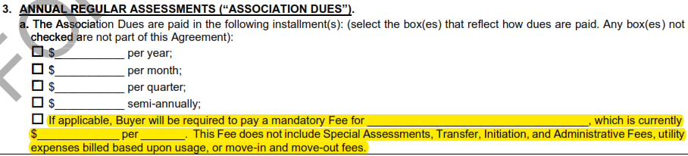
F322 Community Association Disclosure
Previously there was a section under A6 for other association expenses. That was moved to be part of A(3) Annual Regular Assessments (“Association Dues”)

Slide 56
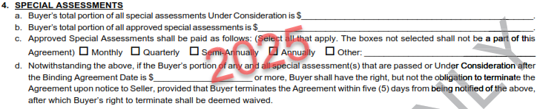
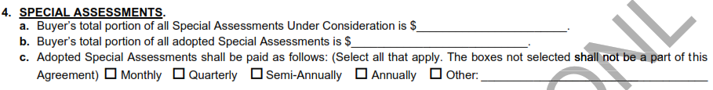
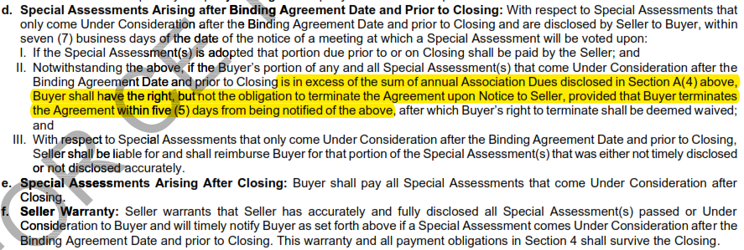
F322 Community Association Disclosure
Special Assessments
A(4)(d) was removed (you don’t want a negotiable term in a disclosure) and now under B(4)(d) Special Assessments Arising after Binding Agreement Date and Prior to Closing, if Buyer’s portion of the Special Assessment exceeds the sum of the disclosed annual Association Dues, the Buyer has the right to terminate within 5 days.

Slide 57
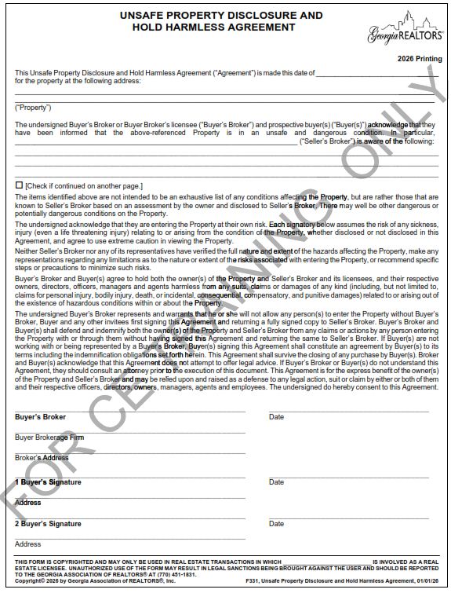
New Form!
F331 Unsafe Property Disclosure and Hold Harmless Agreement

Slide 58
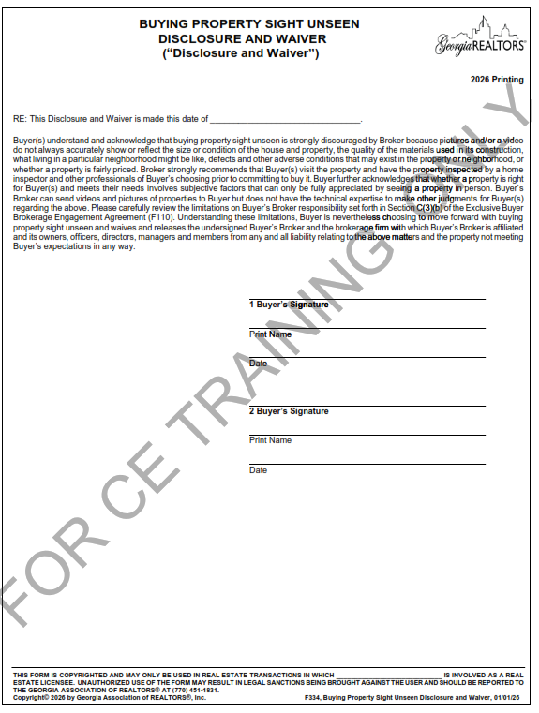
New Form!
F334 Buying Property Sight Unseen Disclosure and Waiver

Slide 59
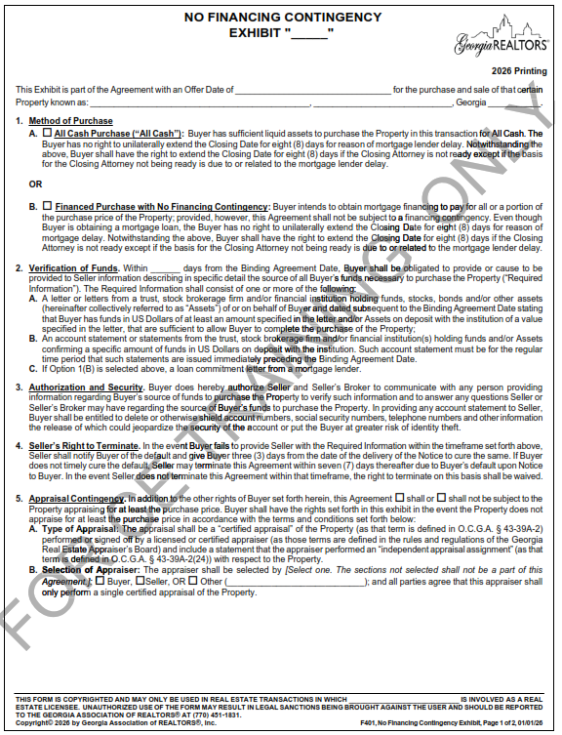
F401 No Financing Contingency Exhibit

Slide 60

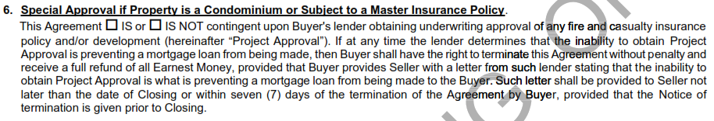
F401 No Financing Contingency Exhibit
New paragraph 6 – Special Approval if Property is a Condominium or Subject to a Master Insurance Policy
To be used if 1(B) is selected. It matches the condo contingency found in other financing exhibits.
However unlike the other financing contingencies in the F401 you must affirmatively check the box to make it part of the agreement.
Remember, this contingency runs until Closing!

Slide 61
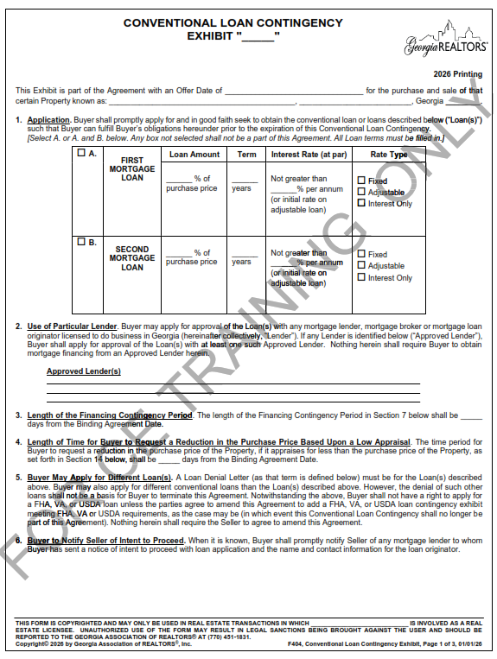
F404 Conventional Loan Contingency Exhibit

Slide 62

F404 Conventional Loan Contingency Exhibit
Paragraph 8 – Use of Approved Lender and Loan Denial Letter–
The loan denial letter must state the basis for the loan denial.
Universal Change: F407, F410, F413

Slide 63


F404 Conventional Loan Contingency Exhibit
Paragraph 10 – Right of Seller to Request Evidence of Buyer’s Ability to Close
Buyers previously had 7 days to produce evidence of their ability to close. That is now reduced to 5 days.
Paragraph 11 – Seller’s Right to Terminate
Buyer’s right to cure the default was reduced from 3 days to 2 days.
Universal Change: F407, F410, F413

Slide 64

F601 Sale or Lease of Buyer’s Property Contingency Exhibit

Slide 65


F601 Sale or Lease of Buyer’s Property Contingency Exhibit
Pay attention to the current listing status.
Knowing the listing status is important because if there is an “Existing Pending Contract” and that Existing Pending Contract terminates the Buyer has the right to terminate our Agreement before the end of the Contingency Period

Slide 66

F601 Sale or Lease of Buyer’s Property Contingency Exhibit
Make sure you know how the kick-out clause works.

Slide 67
Miscellaneous

Slide 68

New Form!
F528 Holder’s Notice to all Parties “Notice”
Can be used by a broker to provide notice to the parties about buyer’s default on earnest money and provide notice of their right to cure.
F528 Holder’s Notice to all Parties “Notice”

Slide 69
New Stipulation! GAR Special Stipulation 333

Slide 70

GAR Special Stipulation 416
Practice Tip!
If you want to include a security deposit for the seller’s temporary occupancy, use GAR Special Stipulation 416.

Slide 71

CO01 Independent Contractor Agreement
Added a section where a broker can limit the activities performed by Licensee

Slide 72

CO01 Independent Contractor Agreement
Updated the obligations of the Licensee
Why might a broker want to make clear that the licensee is responsible for their own auto insurance?

Slide 73
Questions?
Attorneys@campbellandbrannon.com

